Slide 1
SPARK MLlib

Slide 2
What is Spark MLlib?
Spark Mllib is a component of Apache Spark. It is a Machine Learning library that focuses in doing classification, regression and clustering in apache spark framework.
Support for Multiple Algorithms: MLlib includes a variety of machine learning algorithms, such as linear regression, logistic regression, decision trees, random forests, k-means clustering, and more.
Pipelines: Spark MLlib uses a concept called Pipelines to streamline the process of building, tuning, and deploying machine learning models. A pipeline consists of a sequence of stages, including data preparation, feature extraction, and model training.
Integration with Spark Ecosystem: MLlib is tightly integrated with the broader Spark ecosystem, which includes components like Spark SQL, Spark Streaming, and Spark GraphX. This integration allows users to seamlessly incorporate machine learning into their Spark-based data processing workflows.
It provides the API to incorporate the algorithms in languages like
Java
Python
R
Scala
It takes the data from different sources like
HDFS
Hive
HBase
Local System

Slide 3
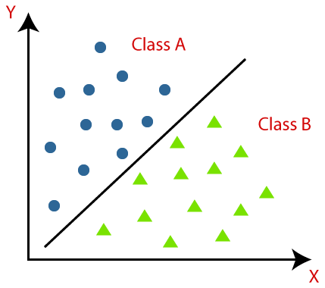
classification
Classification is a process of categorizing data or objects into predefined classes or categories based on their features or attributes. In machine learning, classification is a type of supervised learning technique where an algorithm is trained on a labeled dataset to predict the class or category of new, unseen data.
The main objective of classification is to build a model that can accurately assign a label or category to a new observation based on its features. For example, a classification model might be trained on a dataset of images labeled as either dogs or cats and then used to predict the class of new, unseen images of dogs or cats based on their features such as color, texture, and shape.

Slide 4
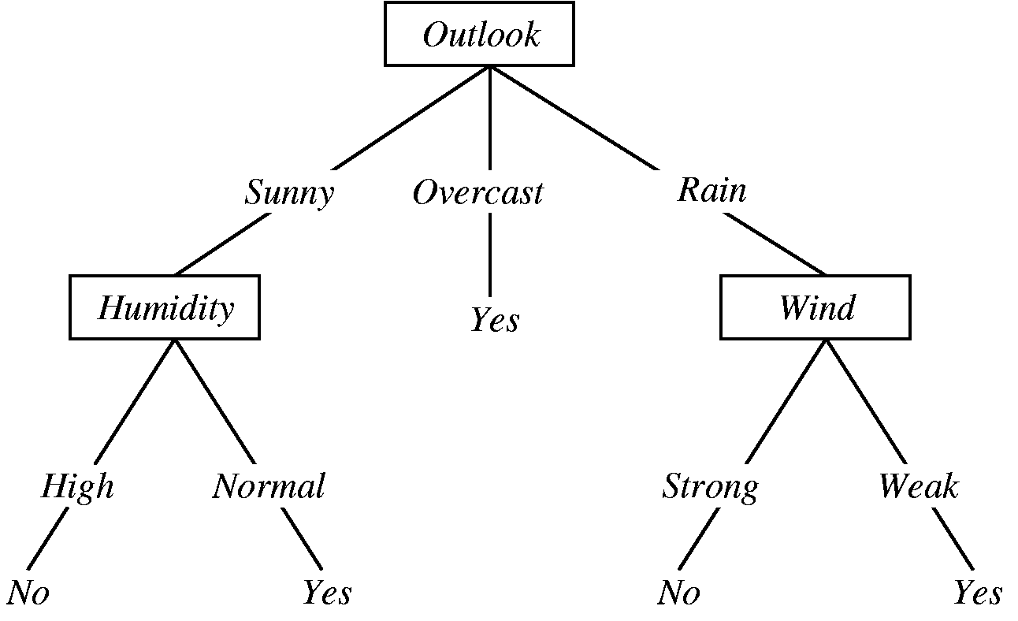
Decision tree
A decision tree is one of the most powerful tools of supervised learning algorithms used for both classification and regression tasks. It builds a flowchart-like tree structure where each internal node denotes a test on an attribute, each branch represents an outcome of the test, and each leaf node (terminal node) holds a class label. It is constructed by recursively splitting the training data into subsets based on the values of the attributes until a stopping criterion is met, such as the maximum depth of the tree or the minimum number of samples required to split a node.
During training, the Decision Tree algorithm selects the best attribute to split the data based on a metric such as entropy or Gini impurity, which measures the level of impurity or randomness in the subsets. The goal is to find the attribute that maximizes the information gain or the reduction in impurity after the split.

Slide 5

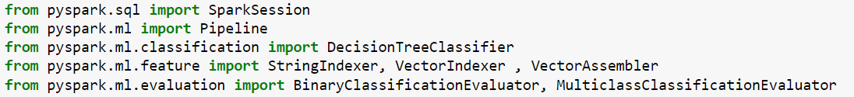
Steps in Decision tree implementation
findspark is used in locating and initializing the spark runtime in the python script which is jupyter notebook here.
When you use findspark.init(), it performs the following tasks:
Locate Spark: It searches for the Spark installation on your system by looking for the SPARK_HOME environment variable. If the variable is not set, it will look for Spark in common installation locations.
Set Spark Home: Once it finds the Spark installation, it sets the SPARK_HOME environment variable to point to the Spark installation directory. This is necessary for Spark to function correctly.
Add Spark to sys.path: It appends the Spark Python libraries to the sys.path. This ensures that when you import the pyspark library in your script, Python can find the necessary modules.
Importing the required libraries.

Slide 6

Creating a spark session using the SparkSession.builder. This session is used as the entry point to any spark functionality. The name for this session can be given by the appName method and this name is displayed in spark UI to help identify our application. .getOrCreate() method is used in obtaining an existing or creating a new spark session, it ensures that only one session is active at a time, if it already exists, that session will be used otherwise a new one will be created.
The dataset is saved as a csv file in the HDFS in Hadoop. A variable data_path that represents the path to a CSV file in HDFS. In this case, the file is located at "/SparkInputSpam/creditcard_2023.csv".
The spark.read.csv method is used to read data from a CSV file and create a DataFrame.
data_path: The first parameter is the path to the CSV file you want to read, which you've specified using the data_path variable.
header=True: This indicates that the first row of the CSV file contains the header, which will be used as column names in the DataFrame.
inferSchema=True: This option enables Spark to infer the data types of each column in the DataFrame based on the content of the CSV file. If set to False, all columns would be treated as strings by default.

Slide 7
In the code other features can also be used based on the dataset.
StringIndexer is used for indexing categorical columns, i.e., converting categorical values into numerical indices. This is often necessary because many machine learning algorithms require numerical input.
VectorIndexer is used for automatically identifying categorical features in a feature vector and indexing them. It is especially useful when you have a feature vector with both categorical and numerical features.
A Pipeline is used to chain multiple stages of machine learning transformations and algorithms together. It helps streamline the process of building, training, and deploying machine learning workflows.

Slide 8



VectorAssembler is used to assemble multiple columns into a vector. Here the various columns from “V1“ to “V28” along with “amount” will be transformed into a single vector named “features”. And all this is done using the transform() method. The result is a dataframe named as “dataset” and will be given as an input to the machine learning algorithm.
The dataset will be divided into trainingData and testData using a randomSplit() method based on the weights given. 70% randomly from the whole dataset would be given to training and other 30% would be given to test.

Slide 9
The DecisionTreeClassifier is a pipeline which is imported from pyspark.ml library and is being implemented here for Decision Tree algorithm.
DecisionTreeClassifier is a machine learning algorithm for classification. It is used to build a decision tree model based on the provided labeled data.
labelCol="Class": Specifies the name of the column in the DataFrame (trainingData and testData) that contains the labels or classes (i.e., the target variable). In this case, it's assumed that "Class" is the column containing the target labels.
featuresCol="features": Specifies the name of the column in the DataFrame that contains the feature vectors. This should match the output column name from the VectorAssembler step in our pipeline.
Fitting in the model
The fit method is called on the DecisionTreeClassifier instance (dtree) with the training dataset (trainingData) as its argument.
The fit method trains the Decision Tree model on the labeled training data and returns a fitted model (model). The model now contains the learned patterns from the training data.

Slide 10
Make predictions
The transform method is called on the fitted model (model) with the testing dataset (testData) as its argument.
The transform method applies the trained model to the testing data, making predictions on the target variable ("Class"). The result is a DataFrame (predictions) that includes the original columns along with additional columns containing predicted labels and probabilities.

Slide 11
BinaryClassificationEvaluator is an evaluator for binary classification models. It is used to evaluate the performance of models that predict binary outcomes (e.g., 0 or 1).
rawPredictionCol="rawPrediction": Specifies the name of the column in the DataFrame containing the raw predictions (scores) produced by the model. The raw predictions are often the output of a binary classification algorithm before applying a threshold to determine the final predicted class.
labelCol="Class": Specifies the name of the column in the DataFrame that contains the true labels or classes. In this case, it's assumed that "Class" is the column containing the true binary labels.
metricName="areaUnderROC": Specifies the evaluation metric to be computed. In this case, it's the area under the ROC curve (AUC-ROC). The ROC curve is a graphical representation of the trade-off between true positive rate (sensitivity) and false positive rate (1 - specificity), and AUC-ROC provides a scalar value summarizing the overall performance.

Slide 12
MulticlassClassificationEvaluator is an evaluator for multiclass classification models. It is used to evaluate the performance of models that predict multiple classes.
labelCol="Class": Specifies the name of the column in the DataFrame that contains the true class labels.
predictionCol="prediction": Specifies the name of the column in the DataFrame that contains the predicted class labels. This is typically generated by the multiclass classification model.
metricName: Specifies the evaluation metric to be computed. The examples provided include:
"accuracy": Measures the accuracy of the model.
"weightedPrecision": Measures the weighted precision of the model, which considers the imbalance in class frequencies.
"weightedRecall": Measures the weighted recall of the model, which considers the imbalance in class frequencies.
"f1": Measures the F1 score, which is the harmonic mean of precision and recall.

Slide 13
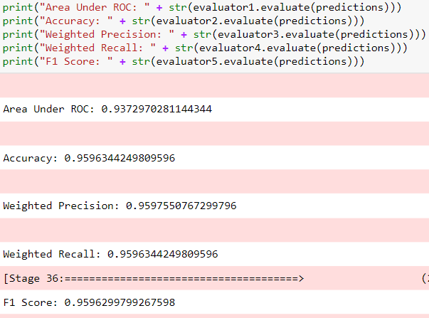

This code allows you to assess the performance of your classification models using various metrics. Each printed line shows the corresponding evaluation metric for the specified aspect of the model's performance. It is a common practice to use multiple metrics to gain a comprehensive understanding of how well a model is performing on different aspects of classification.
The spark.stop() method is used to stop the SparkSession and release associated resources.

Slide 14
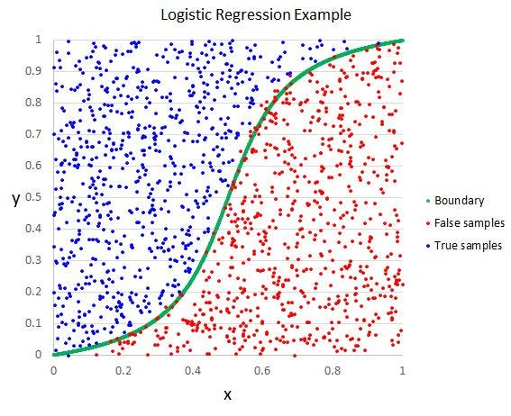
Logistic regression
Logistic regression is a supervised machine learning algorithm mainly used for binary classification where we use a logistic function, also known as a sigmoid function that takes input as independent variables and produces a probability value between 0 and 1. For example, we have two classes Class 0 and Class 1 if the value of the logistic function for an input is greater than 0.5 (threshold value) then it belongs to Class 1 it belongs to Class 0. It’s referred to as regression because it is the extension of linear regression but is mainly used for classification problems. The difference between linear regression and logistic regression is that linear regression output is the continuous value that can be anything while logistic regression predicts the probability that an instance belongs to a given class or not.

Slide 15
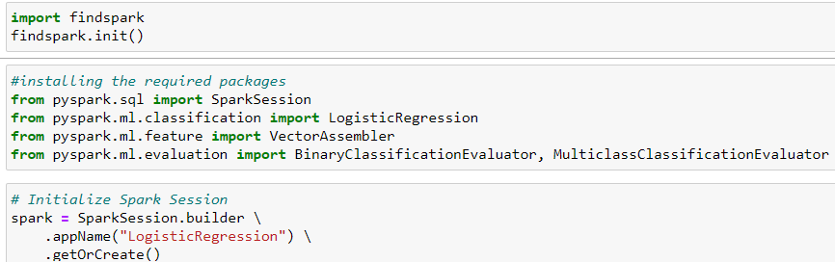
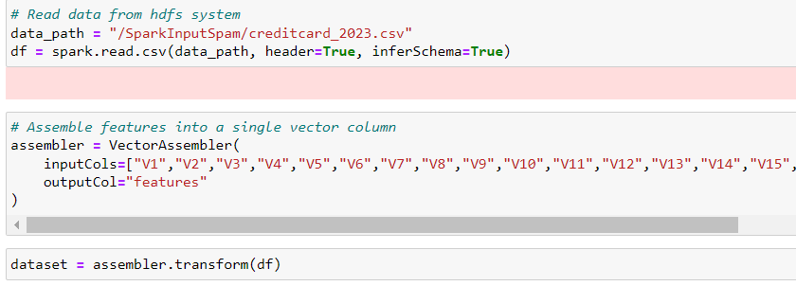

Slide 16
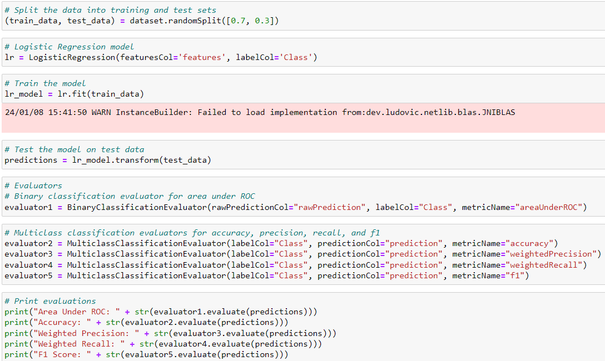

Slide 17
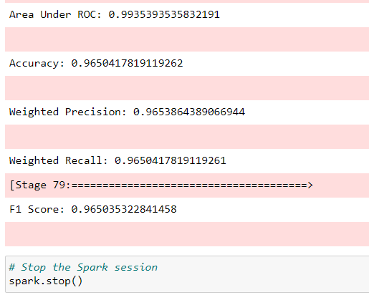

Slide 18
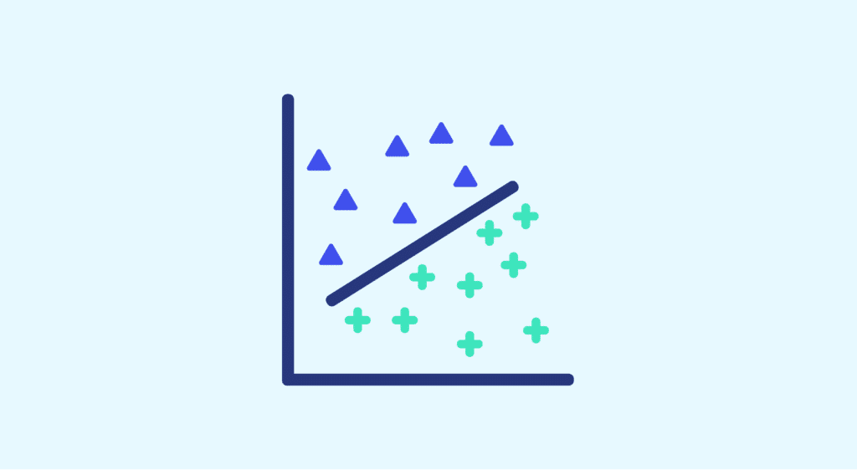
Support vector machine
Support Vector Machine (SVM) is a supervised machine learning algorithm used for both classification and regression. The main objective of the SVM algorithm is to find the optimal hyperplane in an N-dimensional space that can separate the data points in different classes in the feature space. The hyperplane tries that the margin between the closest points of different classes should be as maximum as possible. The dimension of the hyperplane depends upon the number of features. If the number of input features is two, then the hyperplane is just a line. If the number of input features is three, then the hyperplane becomes a 2-D plane.

Slide 19
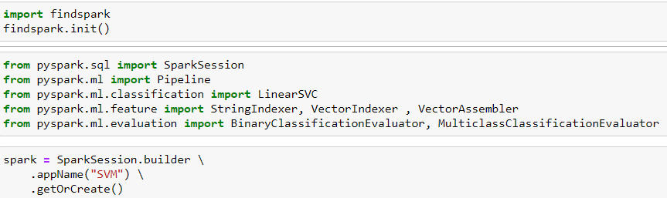
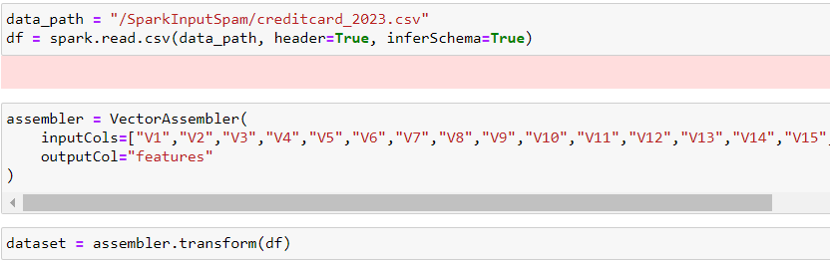

Slide 20
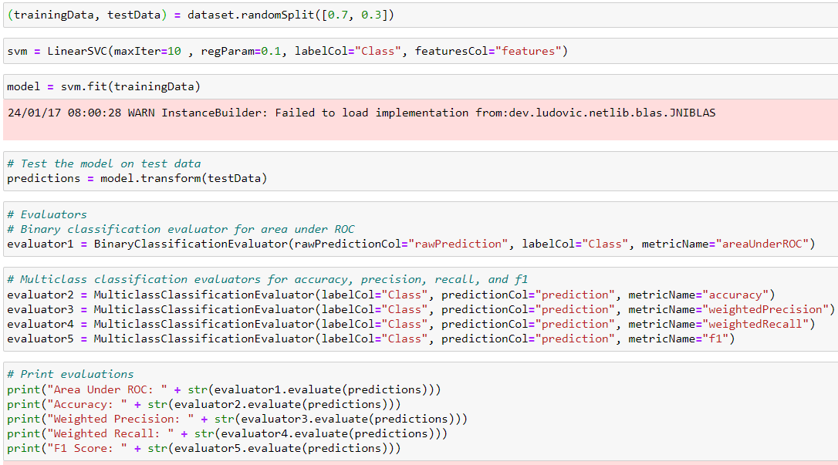

Slide 21
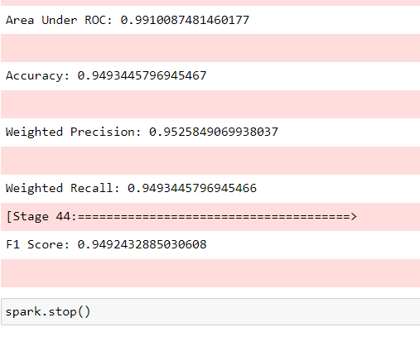

Slide 22
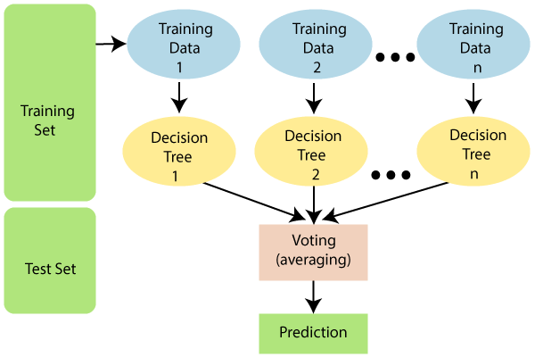
Random forest
Random Forest is an ensemble learning algorithm that operates by constructing a multitude of decision trees during training and outputs the mode of the classes (classification) or mean prediction (regression) of the individual trees for input instances. It is a powerful and widely used machine learning algorithm known for its high accuracy, versatility, and robustness. Random Forest builds multiple decision trees during the training phase. Each tree is trained on a different subset of the dataset (bootstrap samples), and the features considered for splitting at each node are also randomly selected.

Slide 23
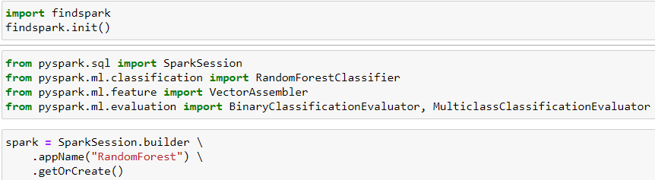
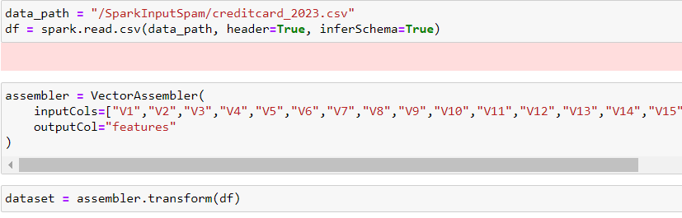

Slide 24
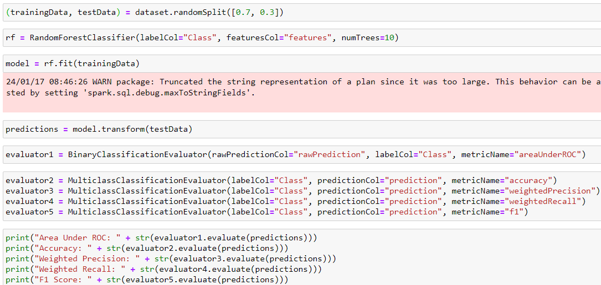

Slide 25
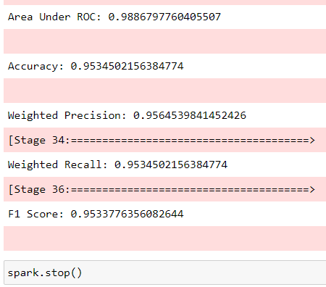

Slide 26
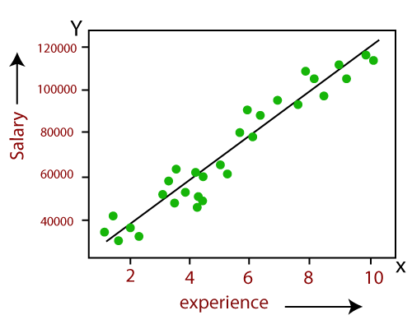
regression
Regression is a supervised learning technique which helps in finding the correlation between variables and enables us to predict the continuous output variable based on the one or more predictor variables. It is mainly used for prediction, forecasting, time series modeling, and determining the causal-effect relationship between variables.
In Regression, we plot a graph between the variables which best fits the given datapoints, using this plot, the machine learning model can make predictions about the data. In simple words, "Regression shows a line or curve that passes through all the datapoints on target-predictor graph in such a way that the vertical distance between the datapoints and the regression line is minimum." The distance between datapoints and line tells whether a model has captured a strong relationship or not.

Slide 27
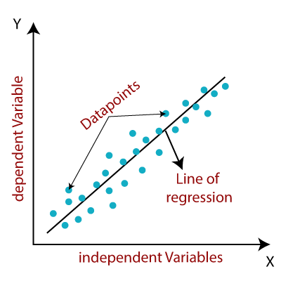
Linear regression
Linear regression is one of the easiest and most popular Machine Learning algorithms. It is a statistical method that is used for predictive analysis. Linear regression makes predictions for continuous/real or numeric variables such as sales, salary, age, product price, etc.
Linear regression algorithm shows a linear relationship between a dependent (y) and one or more independent (y) variables, hence called as linear regression. Since linear regression shows the linear relationship, which means it finds how the value of the dependent variable is changing according to the value of the independent variable.
The linear regression model provides a sloped straight line representing the relationship between the variables.

Slide 28
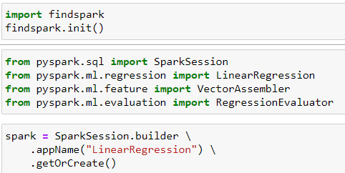
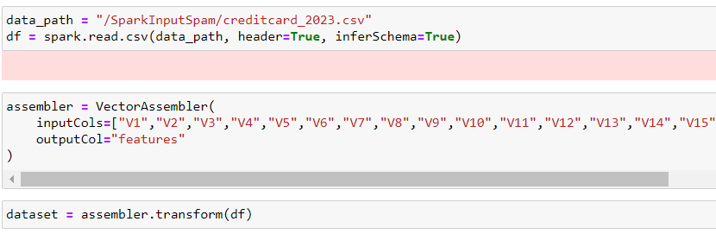

Slide 29
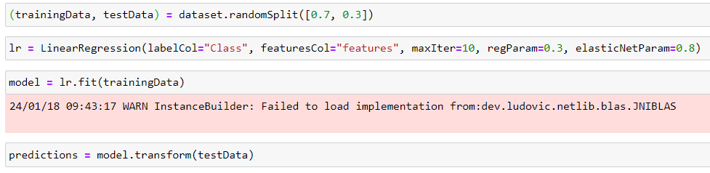

Slide 30
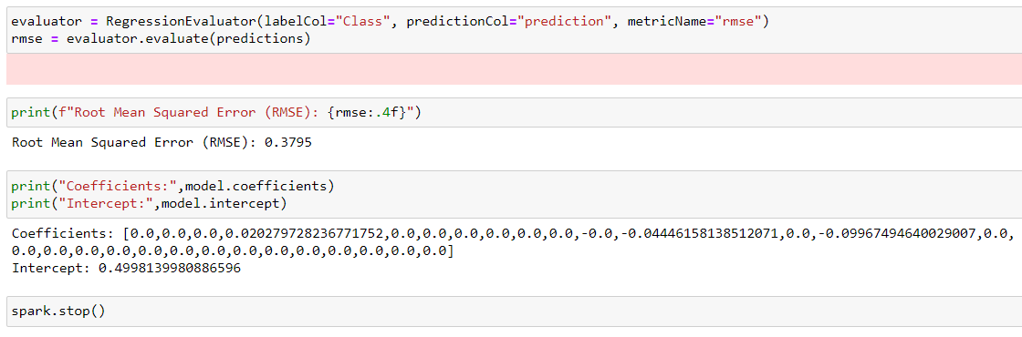

Slide 31
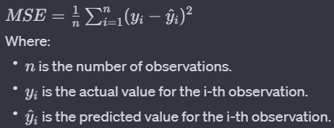
RMSE (Root Mean Squared Error) and MSE (Mean Squared Error) are both metrics commonly used to evaluate the performance of regression models. They are measures of the average squared difference between the predicted values and the actual values.
MSE (Mean Squared Error):
MSE is calculated by taking the average of the squared differences between predicted and actual values.
It is defined as the sum of squared errors divided by the number of observations.
RMSE (Root Mean Squared Error):
RMSE is the square root of the MSE. It is often used because it has the same scale as the target variable, making it more interpretable.
It penalizes large errors more than small errors due to the squaring operation in MSE, and the square root in RMSE brings the error back to the original scale.
RMSE is especially useful when the errors are normally distributed. It provides a measure of the spread of errors and can be more intuitive to interpret.
In both cases, lower values of MSE and RMSE indicate better model performance. When interpreting these metrics, it's essential to consider the scale of the target variable, as the absolute values of MSE and RMSE depend on the scale of the variable being predicted.

Slide 32
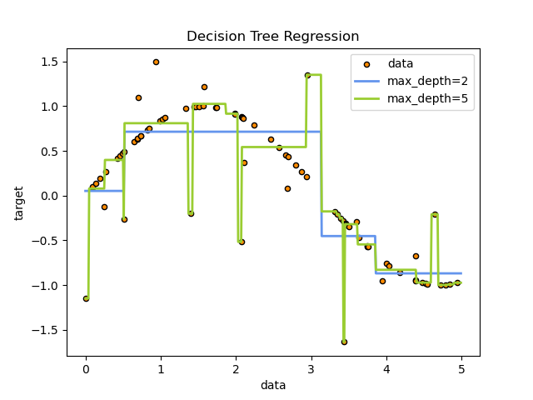
Decision tree regression
Decision tree regression observes features of an object and trains a model in the structure of a tree to predict data in the future to produce meaningful continuous output. Continuous output means that the output/result is not discrete, i.e., it is not represented just by a discrete, known set of numbers or values.
Discrete output example: A weather prediction model that predicts whether or not there’ll be rain on a particular day.

Slide 33
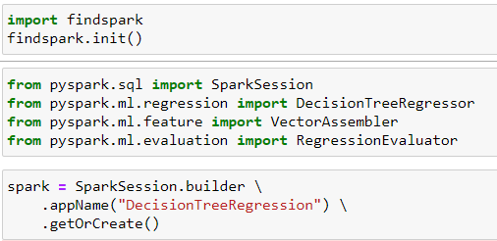
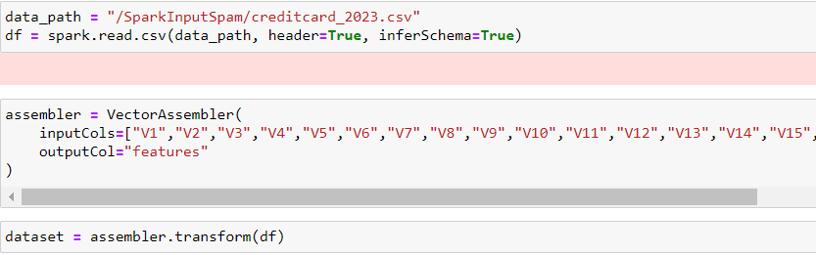

Slide 34
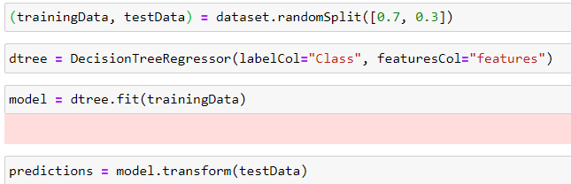

Slide 35
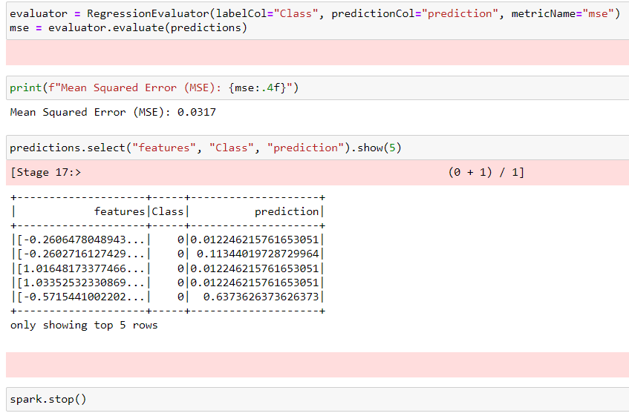

Slide 36
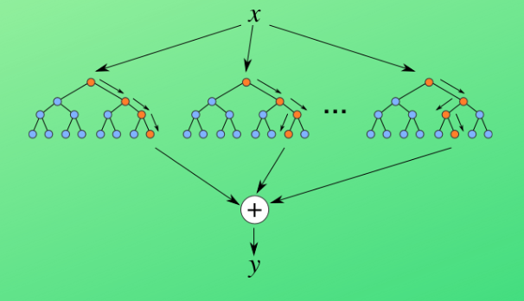
Random forest regression
Random Forest Regression in machine learning is an ensemble technique capable of performing both regression and classification tasks with the use of multiple decision trees and a technique called Bootstrap and Aggregation, commonly known as bagging. The basic idea behind this is to combine multiple decision trees in determining the final output rather than relying on individual decision trees.
Random Forest has multiple decision trees as base learning models. We randomly perform row sampling and feature sampling from the dataset forming sample datasets for every model. This part is called Bootstrap.

Slide 37
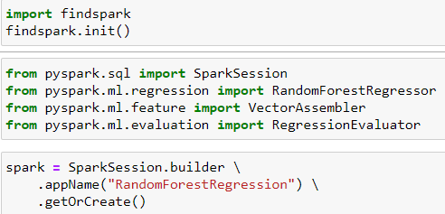
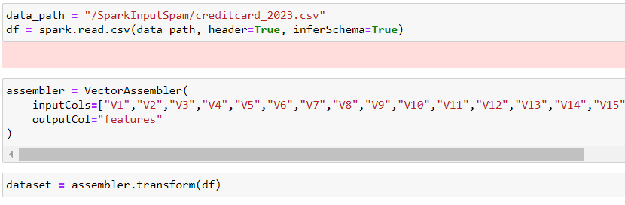

Slide 38
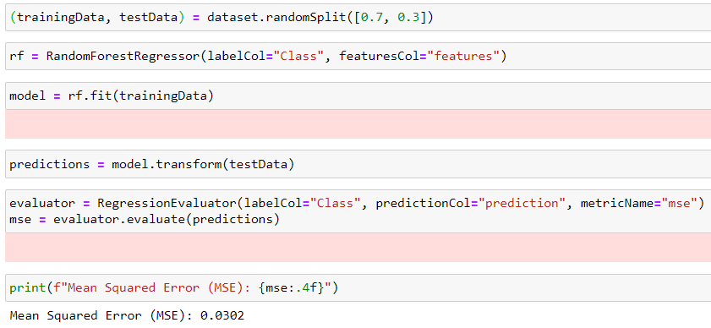

Slide 39
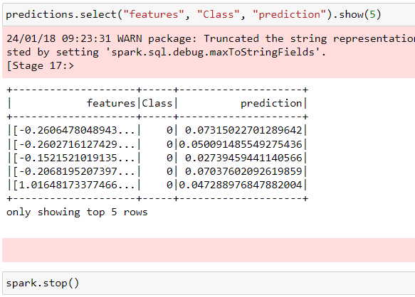

Slide 40
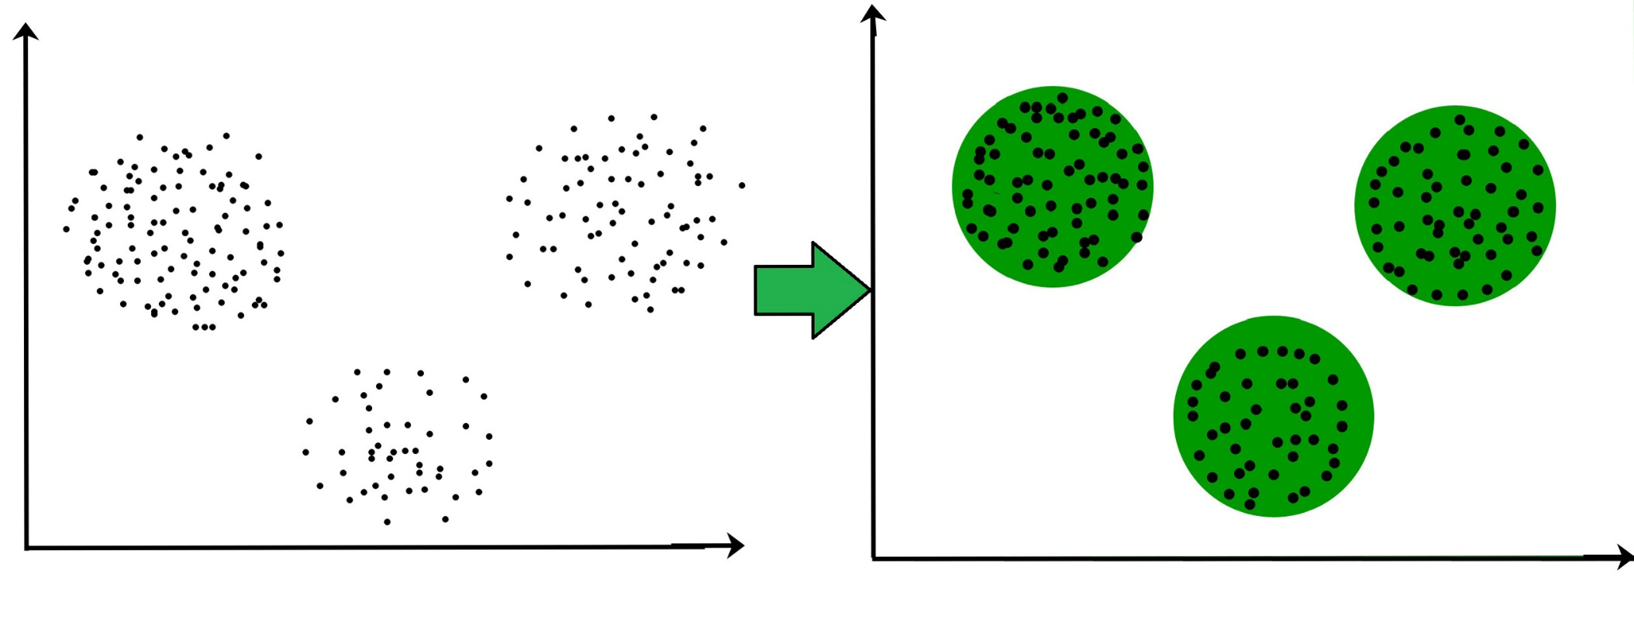
clustering
Clustering is the task of dividing the population or data points into a number of groups such that data points in the same groups are more similar to other data points in the same group and dissimilar to the data points in other groups. It is basically a collection of objects on the basis of similarity and dissimilarity between them.

Slide 41
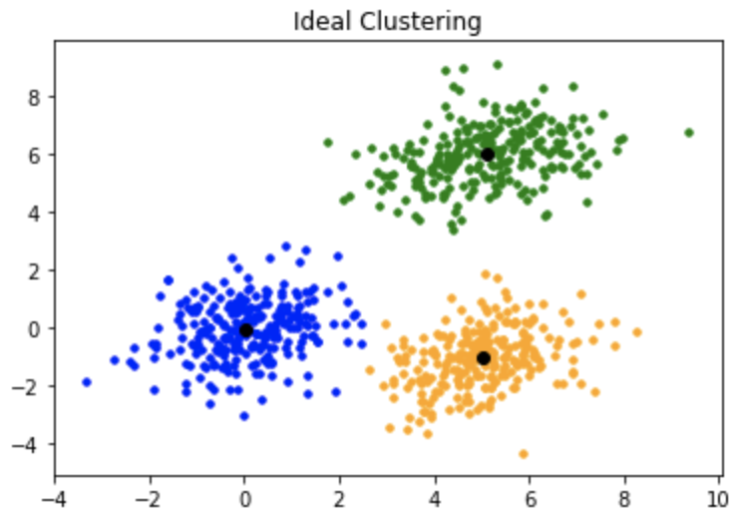
K-means
K-means is a popular clustering algorithm in machine learning and data mining. It is an unsupervised learning algorithm that partitions a dataset into K clusters based on similarity. The primary goal of K-means clustering is to group similar data points together and assign them to the same cluster, while keeping different clusters as distinct as possible.
The algorithm aims to minimize the sum of squared distances between data points and their assigned cluster centroids. It's important to note that the algorithm may converge to a local minimum, and the quality of the clusters can depend on the initial choice of centroids.

Slide 42
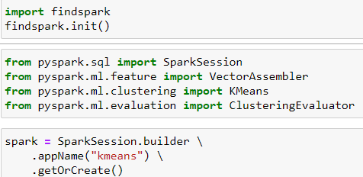
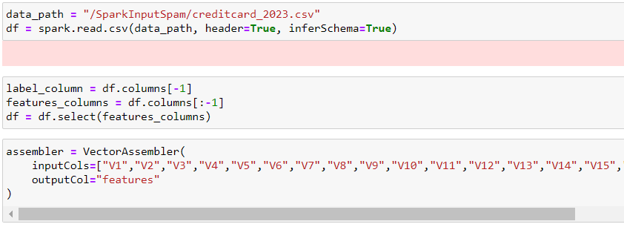

Slide 43
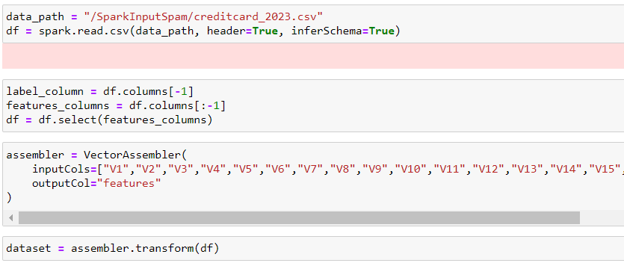

Slide 44
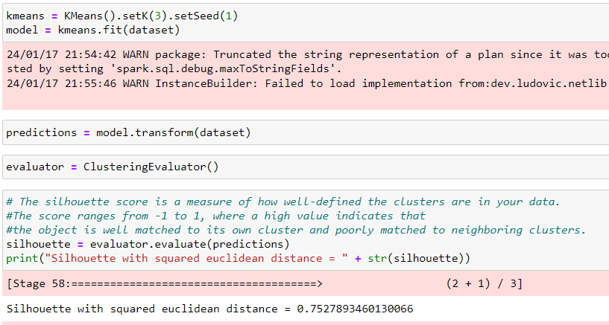

Slide 45
